Slide 1
Overview of EDGE Utility
Presented by: Jeff Sonas
Owner, Sonas Consulting
jeff@sonasconsulting.com
650-619-4853

Slide 2
Introduction
The EDGE Utility is a validated Excel-based utility that was developed by Sonas Consulting for a large biopharmaceutical sponsor during a consulting engagement in 2014-2015.
The sponsor uses this utility to support the controlled process for EDC development of new studies, study amendments, and Global Library (GLIB) volumes within the sponsor’s preferred EDC vendor system.
Within the past year, EDGE (which stands for “EDC Development and GLIB Enforcement”) was used by the sponsor’s data managers and EDC programmers for more than 100 new study builds and study amendments.
By the end of the year, the average study build time (from starting development of User Requirements until production release) had been reduced by two weeks thanks to the use of EDGE.
SLIDE 1

Slide 3
Two types of files used by the EDGE Utility
The EDGE utility makes use of two types of Excel file as inputs.
The User Requirements file (the “UR”) is an Excel spreadsheet prepared by the Data Manager to specify the EDC study design requirements. The data manager starts UR development from a Template UR, populated with all EDC elements from the latest released Global Library (GLIB).
The Build file can be exported from the EDC system once some/all of the EDC study has been programmed. It contains the study metadata for the EDC build. In the following screenshots, the specific EDC system is Medidata Rave, so the Build file is an “ALS file” exported from Rave.
SLIDE 2-A

Slide 4
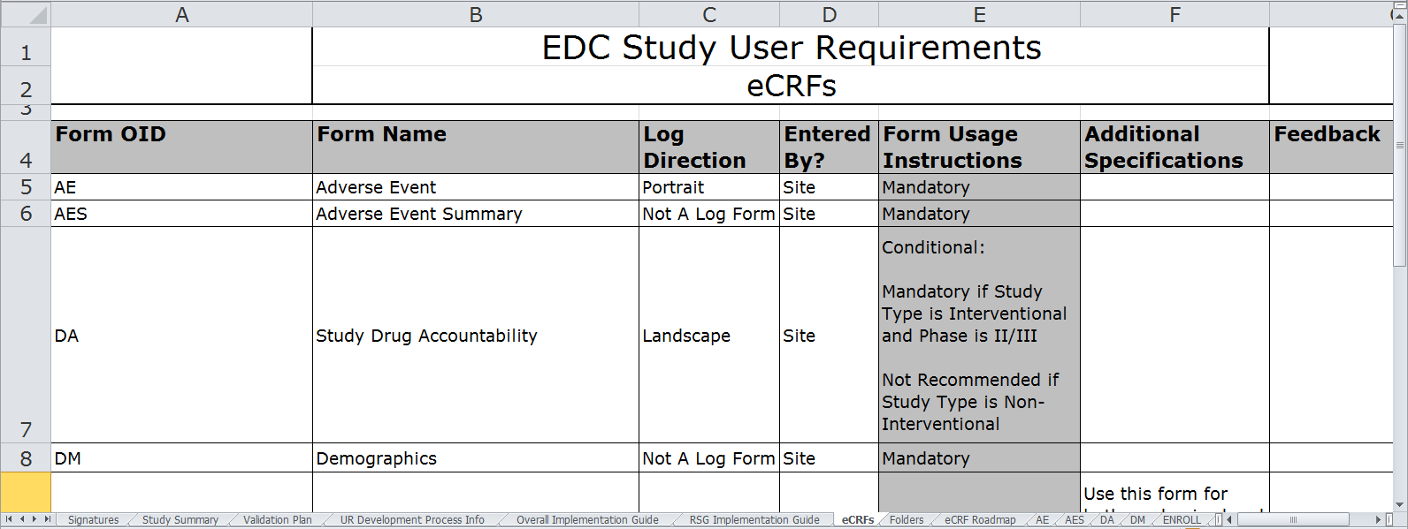
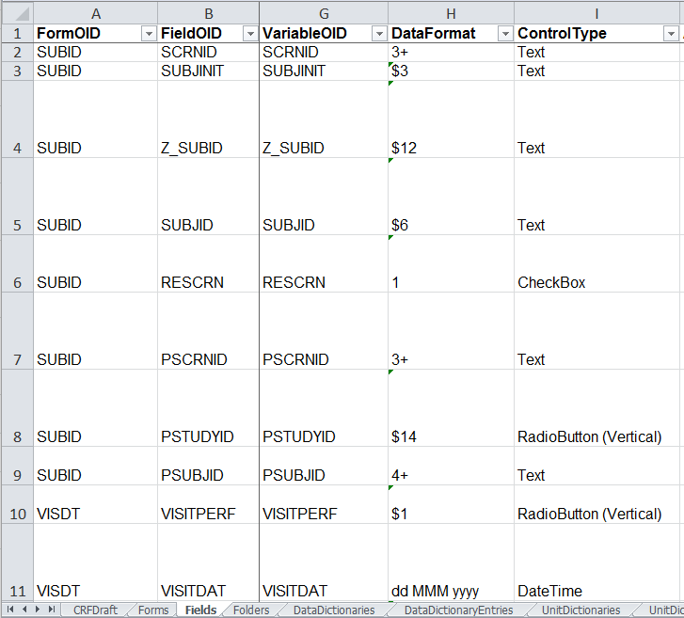
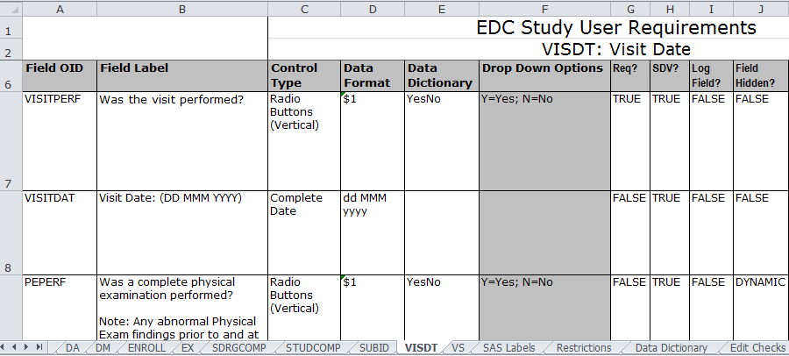
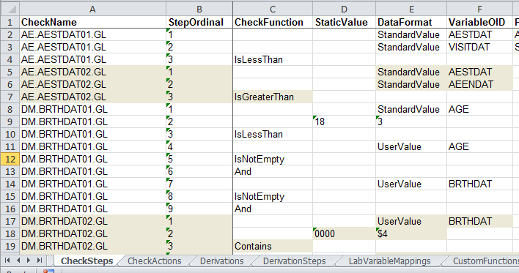
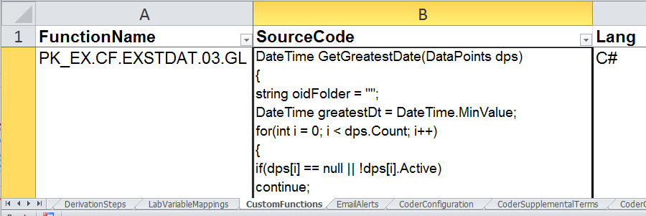
Two types of files used by the EDGE Utility
User Requirements file (Excel spreadsheet)
prepared by data manager
medium detail; does not include all EDC settings
2. Build file (Excel spreadsheet)
exported from built EDC system
very detailed; complete EDC configuration
SLIDE 2-B

Slide 5
What does the EDGE Utility do?
Before any EDC Programming begins, the EDGE utility assists data management in developing, reviewing, and finalizing the User Requirements (UR) file:
UR Autochecker analyzes current UR for errors, inconsistencies, and deviations from sponsor's global and TA-specific standards
EDGE utility supports peer review and Global Library (GLIB) adherence review process, by requiring data manager justification for unfixed issues, and then auto-generating review documentation
Powerful UR Comparison tool allows easy tracking/reporting of UR changes
Generates simplified user requirements export for study team review/approval before UAT
SLIDE 3

Slide 6
What else does the EDGE Utility do?
Once the EDC programming has begun, the EDGE utility assists the data manager and EDC programmer in managing their build to completion:
Build Autochecker compares UR file against Build file, to determine UR-Build mismatches and/or deviations from programming standards
Generate detailed edit check testing checklists, directing the testing based on check type (numerical range, date compare, etc.)
Automated generation of UAT Checklist includes automatic identification of which EDC elements have changed (and therefore require testing) since previous validation
Integrated tracking of UAT testing results (within Excel) enables creation of additional rounds of UAT until all elements are accepted
SLIDE 4

Slide 7
“Dashboard” tab in EDGE gives access to all functions
The EDGE utility is a macro-driven Excel spreadsheet.
All of the details about your EDC study reside inside the UR or Build files, whereas EDGE just keeps track of where those files live, so it can analyze them.
The “Dashboard” tab is your launching point for all functionality.
Other tabs are formatted for output of various reports.
SLIDE 5-A

Slide 8
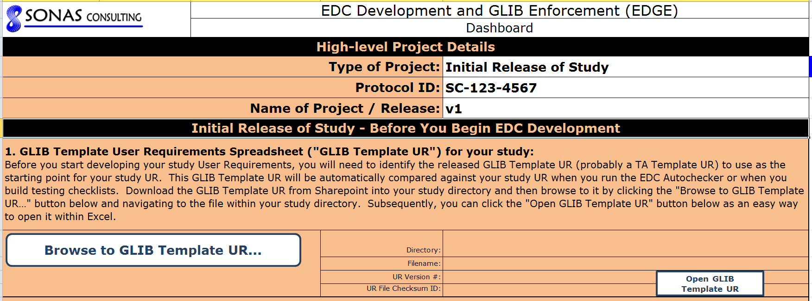
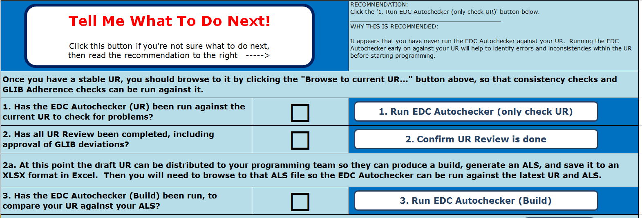
“Dashboard” tab in EDGE gives access to all functions
a) Type in project details and browse to location of GLIB UR template file
b) Whenever there is a newer version of the study UR, browse to it so that EDGE can analyze it
c) Macro buttons give access to many powerful features
SLIDE 5-B

Slide 9
1) UR Autochecker analyzes current UR for errors, inconsistencies, and deviations from sponsor's global and TA-specific standards
Once EDGE knows where your latest study UR resides, it can analyze it for problems.
The UR Autochecker includes hundreds of built-in checks to look for specific problems within the User Requirements.
Many of the findings can be resolved by going into your UR and fixing them.
After fixing some issues, you can save your UR and run the UR Autochecker again
SLIDE 6-A

Slide 10
EXAMPLE: Running the UR Autochecker and fixing a UR issue
We click the button to run the UR Autochecker. A summary tells us there are no definite UR problems, 25 possible UR problems, and 23 deviations from standards. Below that, a detailed listing describes all 48 findings, including their specific locations in the UR.
a) Click button to run the UR Autochecker against the current UR
b) Review summary of UR issues
c) Review detailed listing of UR issues
SLIDE 6-B

Slide 11
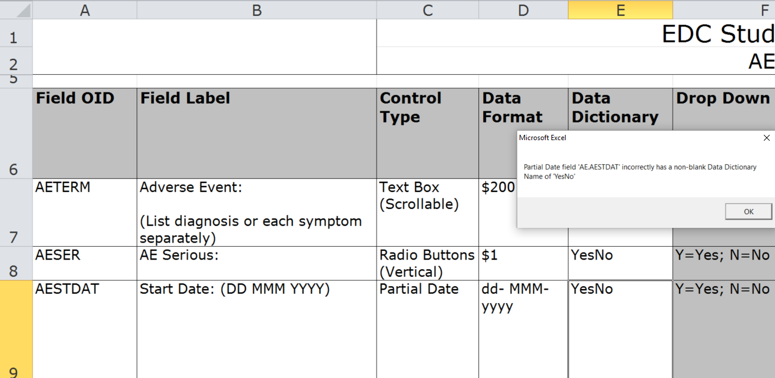
EXAMPLE: Running the UR Autochecker and fixing a UR issue (continued)
The UR Autochecker in EDGE knows that Partial Date fields should not be associated with a data dictionary. Nevertheless, the UR specifies one for the AE.AESTDAT Partial Date field, so EDGE identifies this problem. We double-click on the finding, and EDGE opens the UR, navigates to the AE form tab, highlights the problematic cell, and describes the problem again in a pop-up message.
d) Double-click on issue to drill into UR location
e) UR is opened automatically into Excel, with UR issue highlighted (cell E9, here), and displays pop-up error message.
f) Save UR after fixing UR issue(s), and run Autochecker (UR) again as necessary
SLIDE 6-C

Slide 12
2) EDGE utility supports peer review and Global Library (GLIB) adherence review process, by requiring data manager justification for unfixed issues, and then auto-generating review documentation
As you review the findings of the UR Autochecker, you might not want to fix them all.
Some of those findings may be acceptable, in which case they can be “dismissed”.
Once you dismiss an issue, the UR Autochecker won’t raise it as a problem anymore, even if you run the UR Autochecker again in the future.
Instead, the dismissed issue will show up in the “Dismissed UR Issues” tab, with a text cell where you can explain why it is acceptable as is.
After all UR Autochecker findings have been fixed or dismissed, a checkmark appears in the Dashboard tab telling you it’s time for peer review
SLIDE 7-A

Slide 13
EXAMPLE: Dismissing (not fixing) a UR Issue, with Data Manager Justification
The UR Autochecker in EDGE knows that the RAND and ENROLL forms shouldn’t normally both be in the same study design. Nevertheless, this UR has both forms in it. The data manager marks the checkbox to dismiss the issue, and clicks the button to dismiss the selected issues, moving the issue into the “Dismissed UR Issues tab”. From there, the data manager can enter an explanation.
a) Instead of fixing an issue by changing the UR, instead mark it for dismissal…
b) … then click button to dismiss selected issues; they are moved into the “Dismissed UR Issues” tab
c) In that tab, for each dismissed issue you can type in an explanation for why issue won’t be fixed.
SLIDE 7-B

Slide 14
EXAMPLE: Completing the UR Autochecker and proceeding to UR peer review
The EDGE Utility keeps track of the results of running the UR Autochecker, and maintains a series of checkboxes indicating what the next step should be. As long as there are outstanding issues, it will recommend you fix them and re-run the Autochecker. Once all issues are fixed or dismissed, a checkmark appears for that step, and it is time to move to the next step: UR Review (peer review).
d) Right now there are still 11 issues outstanding, so we are still on step 1: the EDC Autochecker (UR)
e) Once all issues in the UR have been fixed or dismissed, a checkmark is shown for step 1, so it is time for step 2: UR Review
SLIDE 7-C

Slide 15
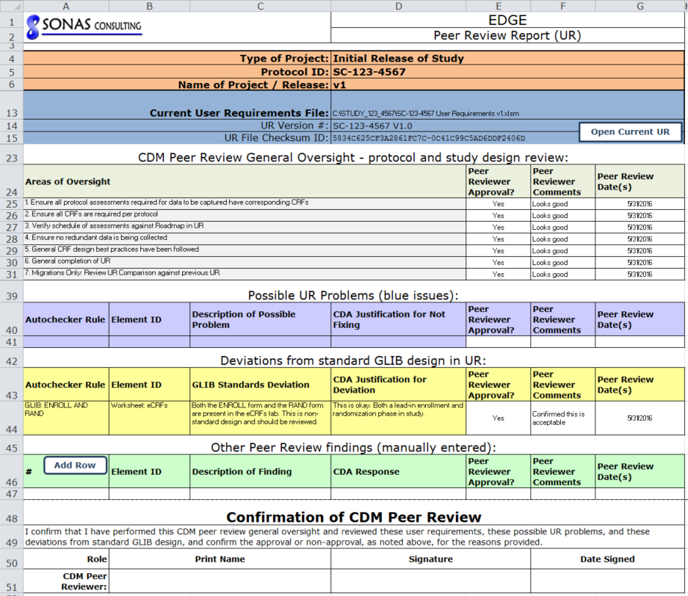
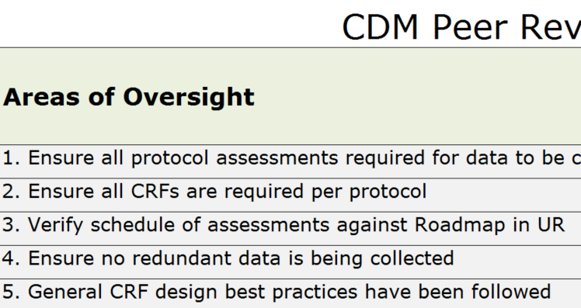
EXAMPLE: Peer Review Report (UR) containing standard and study-specific review items
The Peer Review Report (UR) in EDGE has some areas of oversight that must always be peer-reviewed. In addition, any dismissed UR issues (including data manager justification) also need to be reviewed. In the below example, you can see the issue with RAND/ENROLL forms is included.
f) Data Manager generates Peer Review Report for the peer reviewer to begin filling out.
g) Peer Review Report is built, with standard sections requiring peer reviewer to approve…
h) … as well as study-specific UR issues that were dismissed with justifications, requiring peer review to indicate their approval and comments
SLIDE 7-D

Slide 16
3) Powerful UR Comparison tool allows easy tracking/reporting of UR changes
EDGE keeps track of every UR or Build file that you browse to.
This means that anytime you want, you can specify two UR files and generate a detailed comparison report between them.
This comparison is invaluable in communicating or summarizing recent UR changes to the EDC Programming team
It is also helpful in communicating the differences between your study UR and the GLIB UR, or between 2 versions of your study UR.
Finally, this comparison of UR changes enables the UAT checklist generation, as only the elements that have changed will need UAT.
SLIDE 8-A

Slide 17
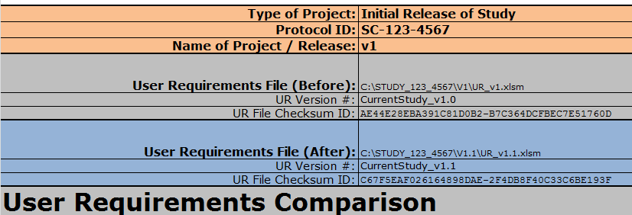
EXAMPLE: UR Comparison between version 1.0 of a study and version 1.1 of a study
In this example, the data manager wants to report on the changes between the previous and current versions of the study UR. There are three new forms (DA, EX, SDRGCOMP) and one changed form (DM). When it comes time to generate UAT checklists, these four forms will be assigned for testing.
a) Header of report indicates it is comparing v1.0 against v1.1
b) UR Comparison report indicates what the new forms are (in this case, DA, EX, SDRGCOMP)
c) Also shows changes to existing elements, such as form name for DM form.
d) UR Comparison report has 24 different sections, not just the above 2
SLIDE 8-B

Slide 18
4) Generates simplified user requirements export for study team review/approval before UAT
The Build file indicates all EDC configuration settings for a study, much more detail than study team members want to review.
Even the UR file, though simpler than a Build file, is too much to digest for many study team members who just want to see the basics.
Therefore EDGE can create an even simpler requirements file, known as the EUR or End User Requirements file.
The EUR displays a visual preview of each eCRF along with high-level information such as the field ID, textbox character limits, etc. Another section summarizes the edit checks that open queries.
SLIDE 9-A

Slide 19
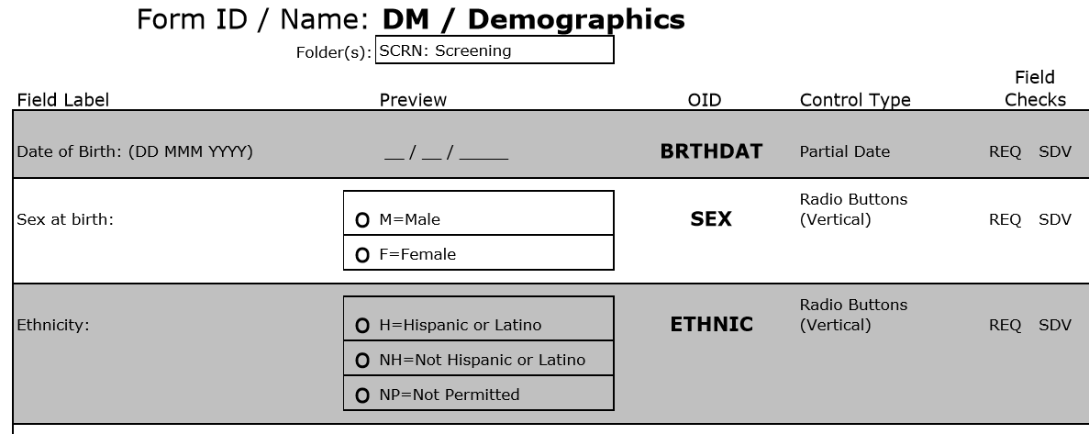
EXAMPLE: Simplified “End User Requirements” can be generated from the regular UR
We would like to secure study team approval of the EDC study design before going to UAT, but the UR/Build files would be hundreds of pages if printed out. EDGE can take your current study design and generate a simplified representation of the requirements, suitable for team review/approval.
a) Data Manager generates simplified “EUR” from existing UR
b) EUR includes visual preview of each eCRF, plus high-level info about each field (control type, whether it’s required, etc.)
c) EUR also includes high-level listing of edit checks, including target field label, query message, and logic
SLIDE 9-B

Slide 20
5) Build Autochecker compares UR file against Build file, to determine UR-Build mismatches and/or deviations from programming standards
The previous items 1) through 4) are specific to UR development, but EDGE also provides powerful help even after the study is built in the EDC system.
Once a Build file is exported by the EDC programmer, EDGE can compare the UR file and Build file directly in order to see whether they match.
The Build Autochecker has a similar user interface to the UR Autochecker, including issue dismissal and peer review reporting.
The Build Autochecker includes more than 100 built-in checks to look for mismatches between UR and Build, freeing up human testers to focus on the aspects of the EDC build that cannot be automatically checked.
After fixing some issues in the Build, you can export an updated Build file, and update the UR if necessary, and then run the Build Autochecker again.
SLIDE 10-A

Slide 21
EXAMPLE: Fixing a Mismatch Between the UR and Build
The Build Autochecker in EDGE knows the Form Name listed in the UR should match the Form Name in the Build file, but one of them says “Adverse Event” and the other says “Adverse Events”. To fix it in the UR, double-click on the UR cell and change it there (in the UR). To see it in the Build file, double-click on the ALS (Build) cell and review it there. Or you can dismiss the issue if acceptable.
a) If you double-click on UR cell, the UR is opened into Excel, with issue highlighted, and pops up message.
b) Or if you double-click on ALS (Build) cell, the Build file is opened into Excel, with issue highlighted, and pops up message.
c) Or you can mark issue for dismissal and eventual peer review, if you don’t need to fix it
SLIDE 10-B

Slide 22
6) Generate detailed edit check testing checklists, directing the testing based on check type (numerical range, date compare, etc.)
Although the Build Autochecker looks for many types of problems that can be automatically identified by comparing UR against Build file, not all problems can be identified this way.
For instance, an edit check might not have the right logic specified in the UR, or might not have been programmed correctly.
EDGE can generate Functional Review Checklists, that provide step-by-step testing instructions to allow a human tester to manually verify that edit checks are correctly specified and programmed.
This includes specialized instructions for several types of edit checks that create queries, such as numerical range checks, date comparisons, fields that are conditionally required based on other fields, etc.
In contrast, UAT Checklists only ask for confirmation of data manager acceptance, rather than containing detailed step-by-step testing instructions.
SLIDE 11-A

Slide 23
EXAMPLE: Creating detailed edit check testing checklists for two common types of check
The User Requirements (UR) file includes a tab for Edit Checks, specifying how each edit check should behave. This includes a plain-language description of the edit check logic, along with an “Open Query Logic Type”, specifying a general categorization of edit check.
a) One standard type of edit check is a Date Comparison check, where a query should be fired if one date is before another date. For instance, if an Adverse Event Start Date comes before a Screening Visit Date.
b) Another standard type of edit check is a Field Should Be Empty check, where a query should be fired if certain conditions are met and also a field is left blank. For instance, if Dosing Frequency is not “Other”, but the “Specify Details” field is filled in.
(continued on next slide)
SLIDE 11-B

Slide 24
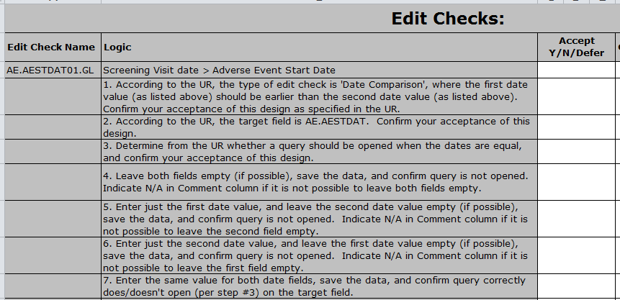
EXAMPLE: Creating detailed edit check testing checklists for two common types of check
When Functional Review Checklists are created for the two edit checks (as specified in the previous slide), the testing instructions are tailored to the specific category of edit check (as defined in UR). This allows specialized edit check testing, by providing appropriate testing instructions.
a) When the testing checklist is automatically generated for the Date Comparison check, it includes instructions for entering various combinations of the two dates, and seeing whether the query fires…
b) …whereas for the Field Should Be Empty check, the tester is instructed to meet the necessary conditions, then not meet those conditions, etc., in order to explore whether the check works.
SLIDE 11-C

Slide 25
7) Automated generation of UAT Checklist includes automatic identification of which EDC elements have changed (and therefore require testing) since previous validation
The EDGE utility can automatically generate UAT checklists.
EDGE will compare your study requirements and study build configuration against what was previously validated, in order to determine which EDC elements (forms, edit checks, etc.) need UAT.
In the case of new study builds, this means comparing your study against the released Global Library (UR and Build) to see what elements are new or modified from the GLIB.
In the case of study amendments, this means comparing your study against the existing production version of the study (UR and Build), to see what elements are new or modified from that existing production version.
SLIDE 12-A

Slide 26
EXAMPLE: Before/After comparison of UR and Build files determines UAT assignments
In this example, the study includes three forms that were newly added from the previous UR, and one form whose name was changed since the previous Build. Any differences in requirements, and/or build configuration, will drive assignment on the UAT Checklist of the new/changed elements.
a) UR Comparison of study requirements indicates three new forms recently added (DA, EX, SDRGCOMP)
b) Build Comparison of study build export indicates one existing form with properties modified (DM)
c) UAT Checklist is generated, assigning all four of these forms (DA, DM, EX, SDRGCOMP) for UAT confirmation.
SLIDE 12-B

Slide 27
8) Integrated tracking of UAT testing results (within Excel) enables creation of additional rounds of UAT until all elements are accepted
The EDGE utility is an Excel spreadsheet, so you can track UAT testing results (pass/fail) within it via normal Excel data entry and file saving, although cell protection in Excel limits which cells are enterable.
After completing a round of UAT, you can click a button to generate a second round (typically with an updated UR and/or Build file).
When generating the new round, if any elements have been added or modified since the previous round, they will be assigned for testing.
In addition, any elements that failed the previous round, or were deferred (not tested), will be assigned again in the next round.
In this way, you can continue with UAT rounds until everything passes.
SLIDE 13-A

Slide 28
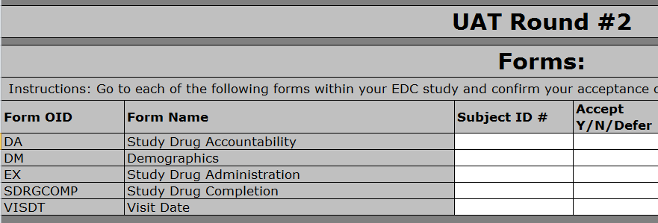
EXAMPLE: UAT Checklist creation automatically figures out what to test each round
In this example, which only shows the Forms sections of the UAT Checklists, a mix of testing results (some passing, some not passing) is recorded into EDGE (via regular Excel data entry). When Round #2 of UAT is generated, anything that didn’t pass Round #1 is assigned again in Round #2.
a) In first round of UAT, most forms are accepted, but DM form fails and testing of VISDT is deferred to the next round.
b) Before generating Round #2, three new forms are added (DA, EX, SDRGCOMP) to UR & Build, so those will be assigned for UAT Round #2, along with anything needing retesting from Round #1.
c) In addition to the three new forms, there are two forms that also need to be assigned again: DM, which had failed in Round #1, and VISDT, which was deferred.
SLIDE 13-B

Slide 29
Questions???
For any questions about the EDGE utility, or to request a demo, please contact Jeff Sonas at jeff@sonasconsulting.com or 650-619-4853.

